Slide 1
ALLOY 6 EXERCISE LECTURE
Authors:
Luca Padalino
Francesca Pia Panaccione
Francesco Santambrogio
Notes:
After having seen the features introduced in Alloy 6, let’s see application examples to fully understand the potential of this new version. This is going to be a fully interactive lecture where you students are supposed to do the exercises by yourself and then we’ll see together what you come up with and what are possible right solutions to what we want to model. let’s start with a simple example: the interrail

Slide 2
CONCURRENCY
1
An Alloy 6 application
CONCURRENCY: a property of a system in which multiple processes or threads can run simultaneously or appear to be running simultaneously.
Scenarios that deal with CONCURRENCY:
distributed systems
multi-threading/multi-tasking applications
data migrations…
Notes:
…Picking up where we left off with the last theoretical lecture, we are going to see an example of concurrency in Alloy 6. Concurrency is a property of a system in which multiple processes or threads can run simultaneously or appear to be running simultaneously. With the new features introduced in Alloy 6, it is much easier to model dynamic systems without resorting to external packages. Thanks to LTL, new temporal connectives, and the new visualizer, it is possible to model and check scenarios that deal with concurrency:
distributed systems
multi-threading/multi-tasking applications
data migrations
We focus now on a model of a simple distributed system…

Slide 3
CONCURRENCY
2
An Alloy 6 application
CONCURRENCY: a property of a system in which multiple processes or threads can run simultaneously or appear to be running simultaneously.
Scenarios that deal with CONCURRENCY:
distributed systems: a collection of independent components located on different systems, sharing messages in order to operate as a single unit.
Notes:
…I remind you what a distributed system is: it is a collection of independent components located on different systems, sharing messages in order to operate as a single unit. It is basically a collection of computers that work together to form a single computer for the end-user...

Slide 4
EXERCISE 1
3
Concurrent communication in a distributed system
sig Node {
edges: some Node
}
sig Message {
var loc: Node
}
fact ConnectedGraph{
all n1, n2: Node |
n1 in n2.edges iff n2 in n1.edges and
!(n1 = n2) and n1.*edges = Node}
fact {
all disj m1,m2:Message |
always !(m1.loc = m2.loc)
}
Collection of independent components
Sharing messages
To operate as a Single unit
+ There can be only one message in a node
Notes:
…We can already start modeling our distributed system from the definition: The independent components by which the system is composed can be modeled as nodes which is our first signature. These nodes share messages, meaning that there must be another signature representing the messages that can change their location (note the keyword var), that is, a node and these nodes sharing messages must be somehow connected, therefore we add a new edges field. Eventually, these independent components operate as a single unit, meaning that all these nodes must be connected to each other, therefore we need a (not strongly) connected graph where the connection between two nodes is bidirectional and there is no self-connection. In addition, we have the constraint that there can be only one message in a node: we have to add a new fact saying that for each pair of different messages they cannot be in the same place simultaneously. As you can see, since the field we are dealing with in this fact is mutable (location), here we have to add a temporal connective (always), meaning that the fact must be true for all the future states including the present one. In the previous fact instead, we are not supposed to insert any temporal connective since the signatures and fields we are dealing with there are all static, so they do not change over the different states and therefore we do not have to constrain their behaviour over time: that fact is implicitly true for every state, we do not have to make explicit «always»…

Slide 5
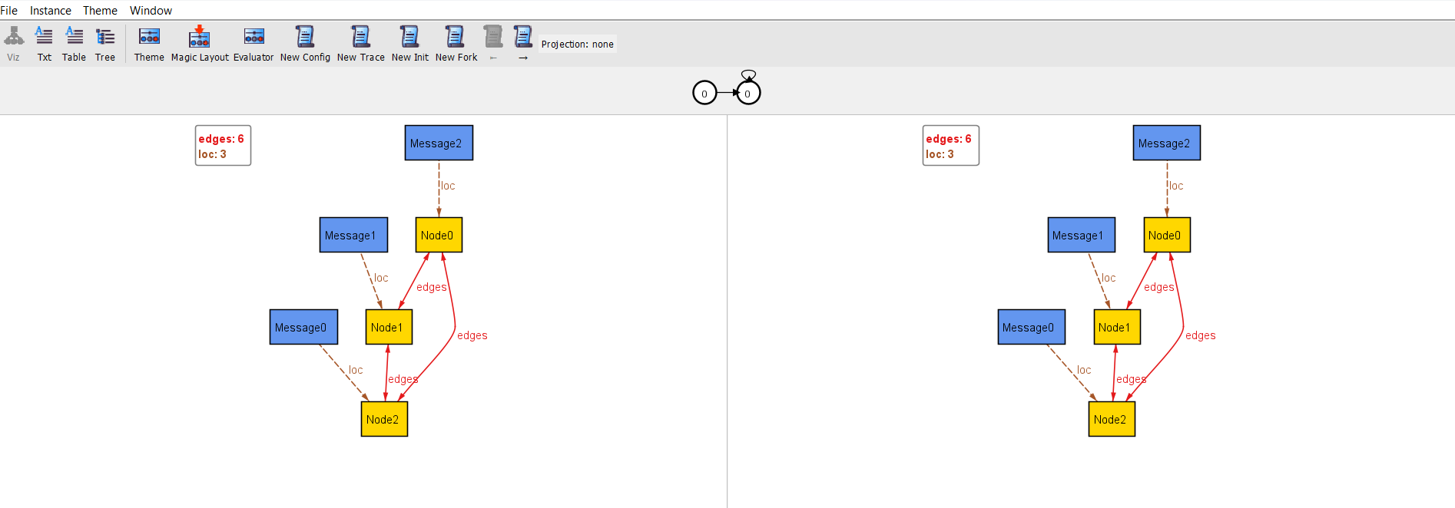
EXERCISE 1
4
Concurrent communication in a distributed system
A possible configuration
Notes:
…This is a possible configuration of the model so far…

Slide 6


EXERCISE 1
5
Concurrent communication in a distributed system
Notes:
…This is a possible configuration of the model so far…

Slide 7
EXERCISE 1
6
Concurrent communication in a distributed system
Messages are exchanged between nodes:
// a message moves to a node if…
pred send[m: Message, n: Node] {
// the node is directly connected to the one where the message is currently located
n in m.loc.edges
// there are no messages in the destination node
no m2: Message | m2.loc = n
// and the location changes to the destination node
m.loc' = n
}
pred sent[m: Message] {
some n: Node | send[m, n]
}
pred unsent[m: Message] {
m.loc = m.loc'
}
Notes:
…Now we focus on the dynamic behavior of our model, namely sharing messages, represented by the mutable field location of the message signature. We want to say that a message m moves to a node n if the node is directly connected to the one where the message is currently located, there are no messages in the destination node, and the location changes to the destination node. In order to generalize the message move, we add a predicate moved that takes as input a message m and says that it moves to a generic node n. On the other hand, if we want to say that the message does not move, we can add a predicate that takes as input the message and says that its location in the next state is the same as the current one…

Slide 8
EXERCISE 1
7
Concurrent communication in a distributed system
Notes:
…This is a simulation of our predicates: note that we must have more nodes than messages, otherwise there are no free nodes and none of the messages are sent..

Slide 9
EXERCISE 1
8
Concurrent communication in a distributed system
Sent
Unsent
Unsent

Slide 10
EXERCISE 1
9
Concurrent communication in a distributed system
Unsent
Sent
Unsent

Slide 11
EXERCISE 1
10
Concurrent communication in a distributed system
Let’s start by moving only one message each step:
// In every step, a certain message moves, while the others remain unsent
fact MessageSending {
always (one m: Message| all m2: Message-m| (sent [m] and unsent[m2]))
}
FULLY DETERMINING the state:
Make explicit what changes during the state transition: sent[m]
Make explicit also what does not change: unsent[m]
Notes:
…Involving temporal logic, we may decide to allow only one message to move each step, or let them move simultaneously
Let’s start by moving only one message each step, while all the others will remain in their place: this is called fully determining the next state, namely, we make explicit what changes during the state transition and also what does not change.
If we don't do this, Alloy will choose an arbitrary value for the next location of the message. Remember to add a temporal connective that makes explicit the behavior of the messages throughout all the traces, for this reason, we add always…

Slide 12
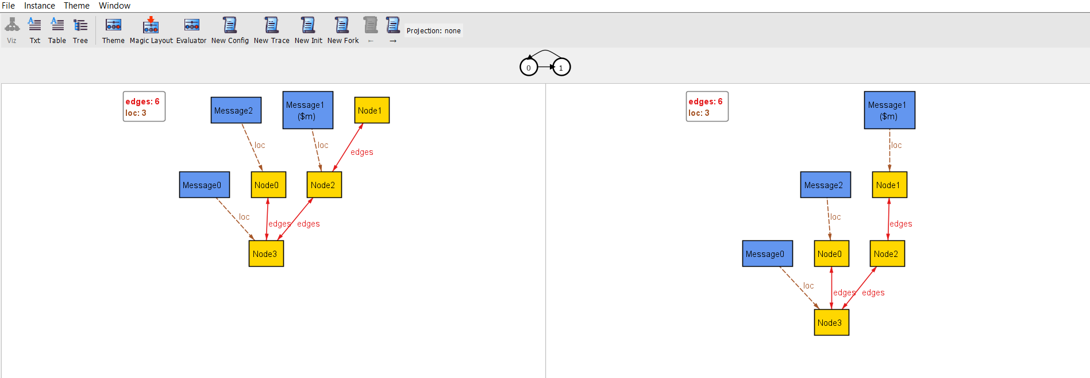
EXERCISE 1
11
Concurrent communication in a distributed system
run { #Message = 3 } for 6
Notes:
…This is a possible configuration of the model so far by running for three messages and at most 6 instances for all the entities …

Slide 13
EXERCISE 1
12
Concurrent communication in a distributed system
0
Notes:
…and this is the simulation…

Slide 14
EXERCISE 1
13
Concurrent communication in a distributed system
1
Unsent
Sent
Unsent
Notes:
…This is a possible configuration of the model so far…

Slide 15
EXERCISE 1
14
Concurrent communication in a distributed system
Let’s send multiple messages simultaneously:
// All the messages are sent
fact SendingOrNot {
all m: Message | always (sent [m] or unsent [m])
}
FULLY DETERMINING the state:
Make explicit what changes during the state transition: sent[m]
Make explicit also what does not change: unsent[m]
Notes:
…Now let’s add real concurrency in this model by allowing all the messages to be sent or not. Again, we must fully determine the next states if we don’t want Alloy to do whatever it wants…

Slide 16
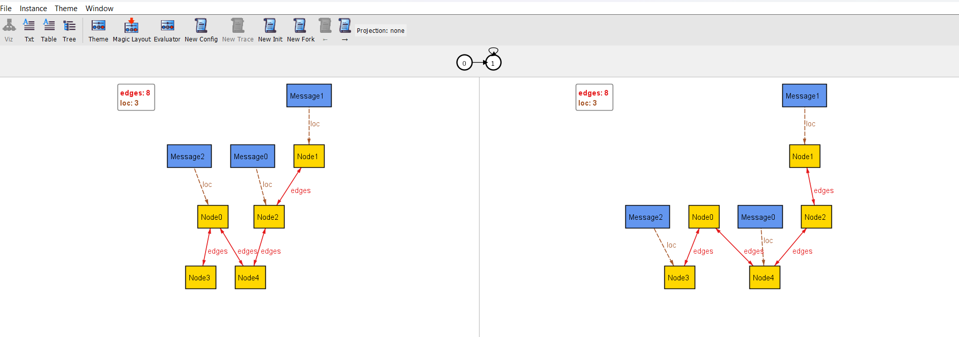
EXERCISE 1
15
Concurrent communication in a distributed system
run { #Message = 3 } for 6
Notes:
…This is a possible configuration of the model so far…

Slide 17
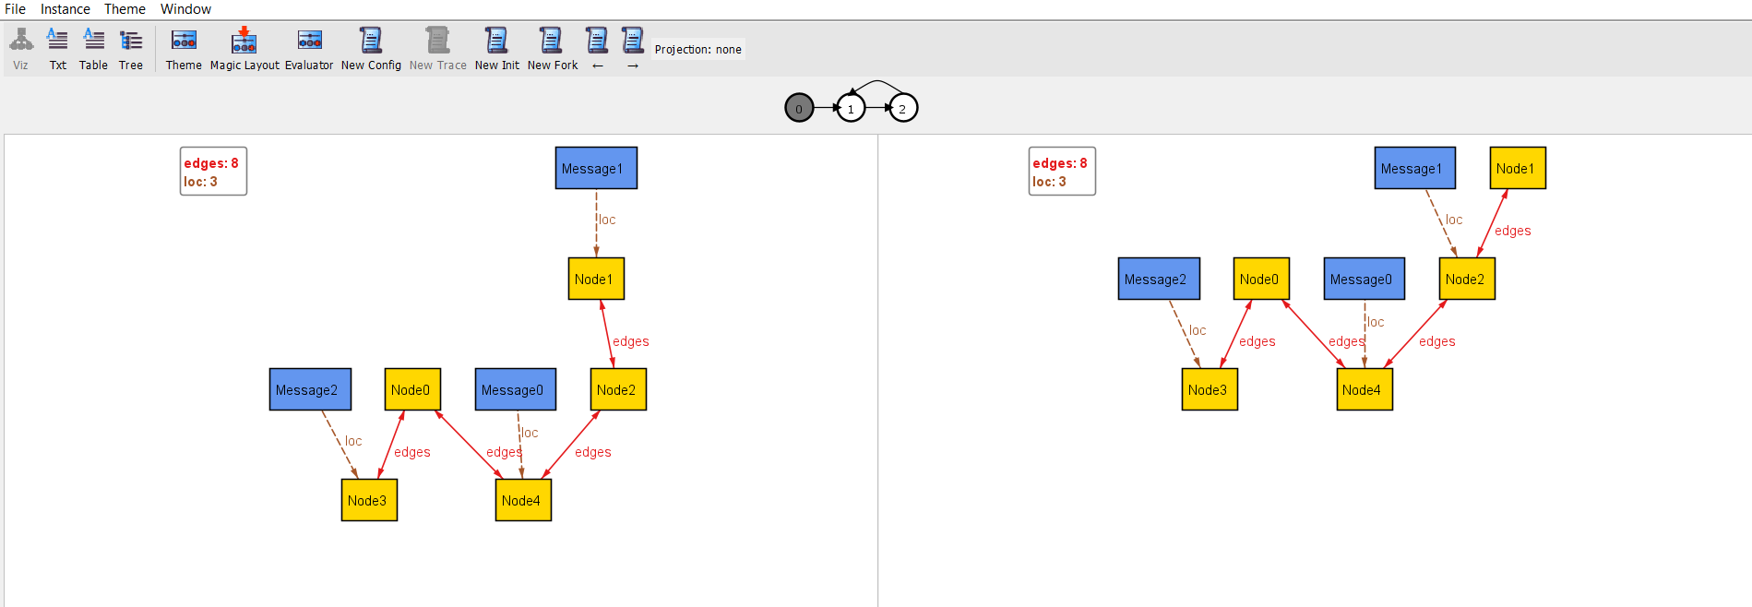
EXERCISE 1
16
Concurrent communication in a distributed system
run { #Message = 3 } for 6
Notes:
…the initial lasso given by Alloy 6 had only two states, if we want to go further we have to click on next and then on new fork…

Slide 18
EXERCISE 1
17
Concurrent communication in a distributed system
0
Notes:
…This is a simulation of the visualizer…

Slide 19
EXERCISE 1
18
Concurrent communication in a distributed system
Unsent
1
Sent
Sent
Notes:
…This is a simulation of the visualizer…

Slide 20
EXERCISE 1
19
Concurrent communication in a distributed system
2
Sent
Unsent
Unsent
Notes:
…This is a simulation of the visualizer…

Slide 21
EXERCISE 1
20
Concurrent communication in a distributed system
sig Node {
edges: some Node
}
fact ConnectedGraph {
all n1, n2: Node |
n1 in n2.edges iff n2 in n1.edges and
!(n1 = n2) and n1.*edges =Node
}
sig Message {
var loc: Node
}
fact {
all disj m1,m2: Message |
always !(m1.loc = m2.loc)
}
pred send[m: Message, n: Node] {
n in m.loc.edges
no m2: Message | m2.loc = n
m.loc' = n
}
pred sent[m: Message] {
some n: Node | move[m, n]
}
pred unsent[m: Message] {
m.loc = m.loc'
}
fact SendingOrNot {
all m: Message | always moved [m]
}
Notes:
…And this is the entire code. As you can see, a few lines of code are sufficient to model our concurrent system, while in Alloy 5 dynamic modeling was trickier and longer…

Slide 22


EXERCISE 2
21
Interrail: general context
A Person wants to organize an interrail.
An interrail is a type of travel where the traveler can move to different cities by train.
The person has a pass where all the cities he can visit are specified.
The travel includes European cities.
Notes:
The second exercise consists in modeling interrail travel. There is a person who wants to organize an interrail. An interrail is a type of travel where the traveler (the person) can move to different cities by train. The person has a pass where are specified all the cities he can visit. The travel includes European cities only…

Slide 23
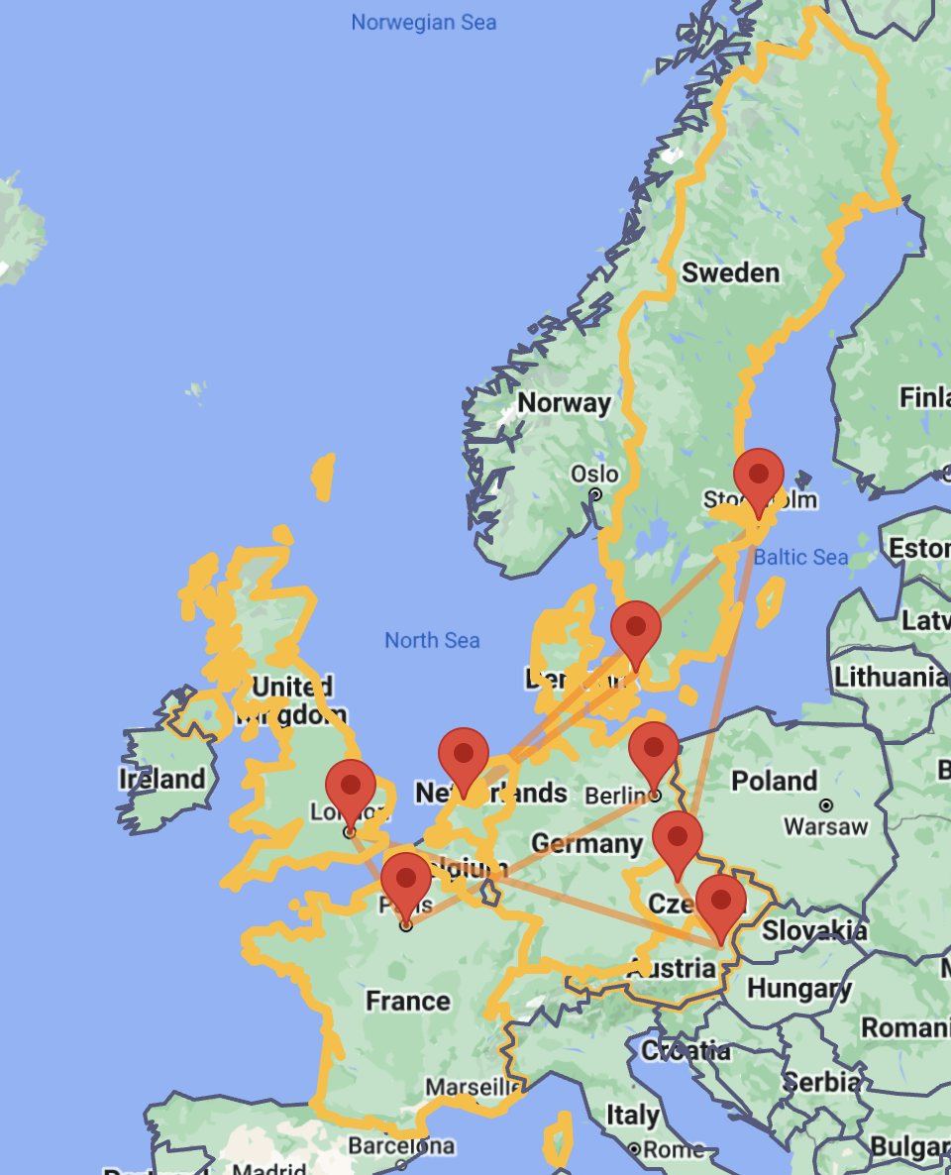
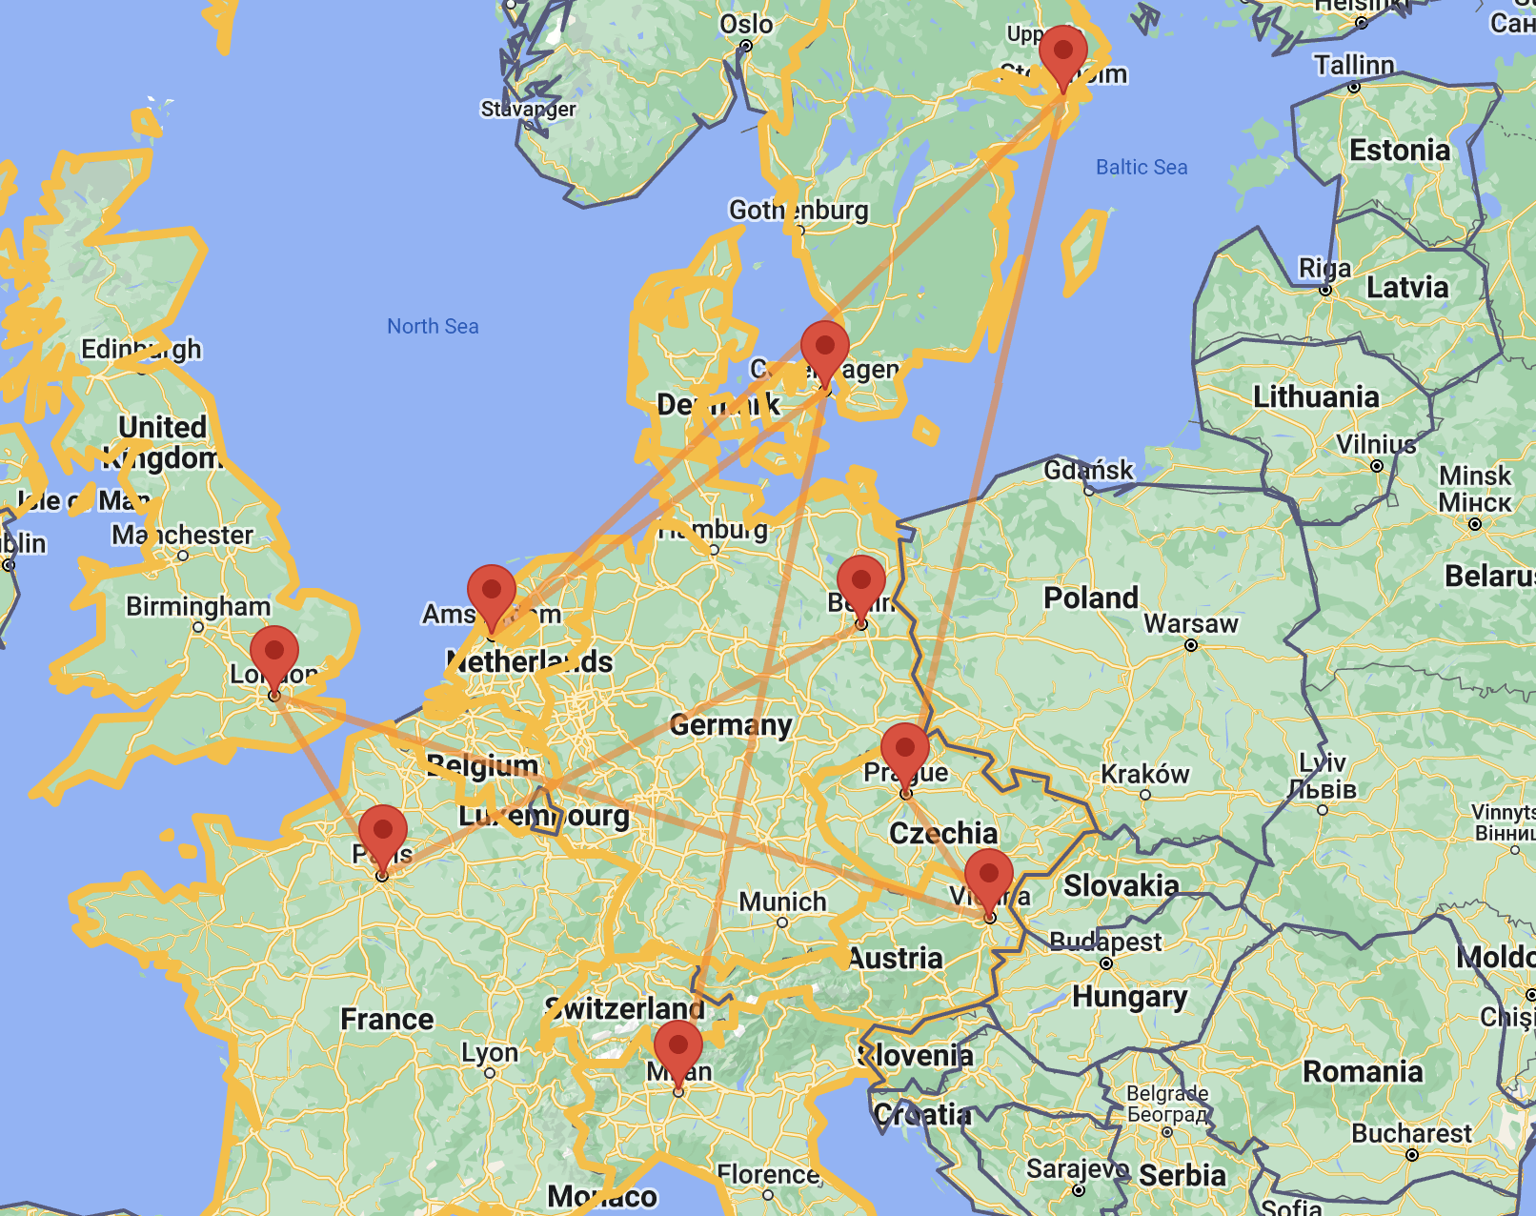
EXERCISE 2
22
Interrail: general context
Cities must be interconnected through railways in order to create an itinerary.
Notes:
The cities must be interconnected through railways in order to create an itinerary: this is a graphic real example taken from the interrail site…

Slide 24
EXERCISE 2
23
Interrail: general context
We assume that the Person can move only to the cities that he has not visited yet.
Notes:
We assume aslo that the person can move only to cities that he has not visited yet

Slide 25

EXERCISE 2
24
Interrail: general context
We want to keep track of whether the person is traveling or has arrived at the final destination.
Final destination=Milan
Notes:
…Eventually, We want to keep track of whether the person is traveling or has arrived at the final destination, that is the same as the starting point, namely Milan…

Slide 26
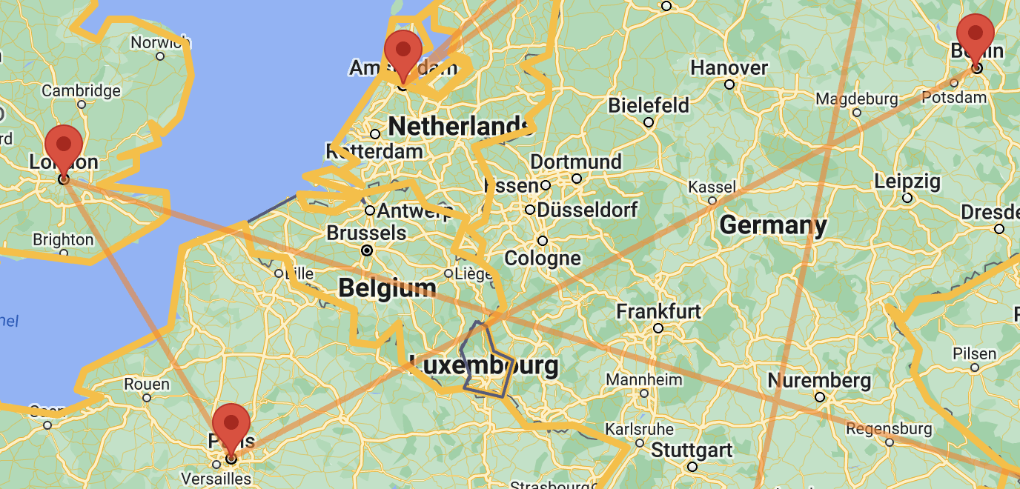
EXERCISE 2
25
Interrail: signatures
sig City {
linkedWith: some City,
name: disj one EuropeanCities
}
enum EuropeanCities {
Milan, Berlin, Paris, London, Vienna, Prague, Stockholm, Amsterdam, Copenaghen
}
Notes:
…let’s add the signatures of our model: firstly we have a signature city with a static field linkedWith representing the set of cities with which is linked (we suppose that there is no city that is not linked with any other city, so we put some), and a static field name that serves as the identifier whose value is one of the European Cities enumeration literal…

Slide 27



EXERCISE 2
26
Interrail: signatures
sig Person {
pass: some City,
var loc: City,
var visited_cities: set City,
var status: Status
}
enum Status {
Travelling, AtDestination
}
t0
t1
t2
t3
Notes:
…Now we add the signature Person with a static field pass where we record the cities included in the interrail pass (static since remains the same throughout the travel), a field location (obviously var) for the person which is a relation with the signature City. We add a variable field visited-cities to record the cities he has visited so far and a variable field status which is basically a boolean telling whether the person is traveling or he has finished traveling and he is at the destination…

Slide 28
EXERCISE 2
27
Interrail: contraints
// Two cities are connected to each other
fact BidirectionalConnection {
all c1, c2: City | c1 in c2.linkedWith iff c2 in c1.linkedWith and !(c1 = c2) and c1.*linkedWith = City
}
// At the beginning of the interrail, the traveler has not visited any cities yet
fact NoVisitedCitiesAtTheBeginning {
all p:Person | no p.visited_cities
}
Notes:
…Now we want to express some properties of our model through facts: first of all we want to say that two cities are connected to each other. A possible solution can be that for each pair of cities, c1 is linked with c2 iff c2 is linked with c1, thy are different and at last we can add that the graph of cities is connected, namely that there is always a path from one city to another. Another fact we want to add is the one constraining that at the beginning of the interrail, the traveler has not visited any cities yet: we can say that for each person p, his visited-cities field is empty…

Slide 29
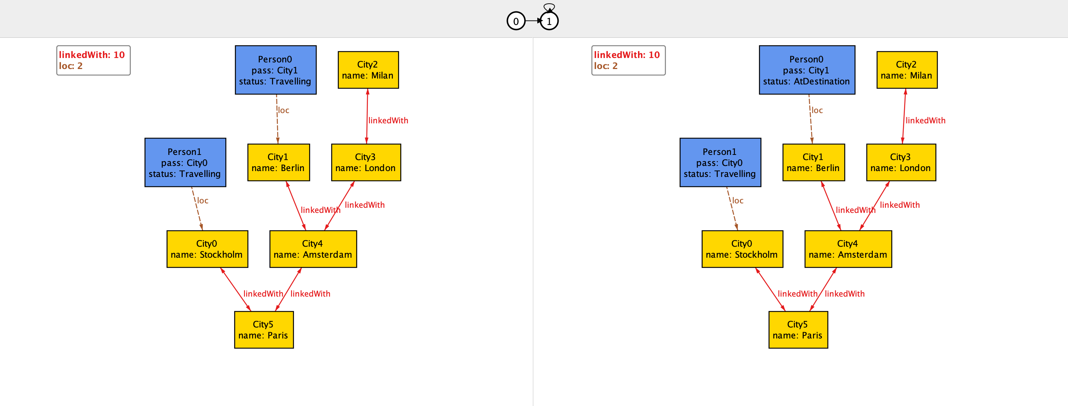
EXERCISE 2
28
Interrail: visualizer
So far, only static constraints or constraints about the first current state, not about the behavior of the system during state transitions
pred world1{#City = 6 and #Person = 2}
run world1 for 10
Notes:
… So far, only static constraints or constraints about the first current state are made, not about the behavior of the system during state transitions. This is a possible configuration shown by the visualizer for our model so far…

Slide 30
EXERCISE 2
29
Interrail: visualizer
. . .How can we write a function that defines the movement of a person 'p' to a city 'c’ ?
What conditions must be applied so that the logic of the system does not break down?. . .
The city ‘c’ must be linked to the one where I am currently in
I must have the pass for the city ‘c’
I must not have visited city ‘c’ before
The city ’c’ must be different from the one I am currently in
The place where I will be in the next state becomes ‘c’
’c’ will be among the visited cities
Notes:
…Now, How can we write a function that defines the movement of a person 'p' to a city 'c’ ? What conditions must be applied so that the logic of the system does not break down?. . .
The city ‘c’ must be linked to the one where I am currently in
I must have the pass for the city ‘c’
I must not have visited city ‘c’ before
The city ’c’ must be different from the one I am currently in
The place where I will be in the next state becomes ‘c’
’c’ will be among the visited cities

Slide 31
EXERCISE 2
30
Interrail: predicates
// A given person travels to a given city
pred move[p: Person, c: City] {
c in p.loc.linkedWith and c in p.pass and c not in p.visited_cities and c not in p.loc
p.loc' = c
c in p.visited_cities'
}
Notes:
…so let’s define the predicate that represents the travel of a person from one city to another and therefore defines the state transition of our model. We say that Given a person p and a city c , person p moves to c if c is connected to the city where p is in the current state and c is different from the city where p is in the current state, if c is not among the cities visited by p and if person p has a pass for city c. Then,C is among the cities visited by p in the state i+1...

Slide 32


EXERCISE 2
31
Interrail: predicates
// A given person has moved
pred moved[p: Person] { some c: City | move[p,c]}
// A person stays in his location
pred unmoved[p: Person] { p.loc = p.loc'}
Notes:
…From the previous predicate, other two follow: one saying that a given person has moved, another saying that a given person has not moved…

Slide 33

EXERCISE 2
32
Interrail: question
// Travelers start their journey from Milan and eventually they will come back
fact StartingFromMilanAndComingBack {
all p:Person | p.loc.name = Milan and p.status = Travelling
and (eventually (p.loc.name = Milan and p.status=AtDestination))
}
fact StartingFromMilanAndComingBack {
all p:Person | p.loc.name = Milan and p.status = Travelling
and after (eventually (always p.loc.name = Milan and p.status=AtDestination))
}
fact StartingFromMilanAndComingBack {
all p:Person | p.loc.name = Milan and p.status = Travelling
and after (eventually (p.loc.name = Milan and p.status=AtDestination))
}
Notes:
…Now we want to constrain that travelers start their journey from Milan and eventually they come back: which of the following is the correct answer?...

Slide 34

EXERCISE 2
33
Interrail: question
https://app.wooclap.com/LFYKLS?from=instruction-slide

Slide 35
EXERCISE 2
34
Interrail: costraints
// Travelers start their journey from Milan and then they will come back
fact StartingFromMilanAndComingBack {
all p:Person | p.loc.name = Milan and p.status = Travelling
and after (eventually (always p.loc.name = Milan and p.status=AtDestination))
}
// Travelers do not come back to Milan if they have not visited all the cities of the pass before
fact VisitingAllCities {
all p: Person, c: City | (c in p.pass and !(c.name = Milan)) implies (always (after !(p.loc.name = Milan) until (c in p.visited_cities)))
}
Notes:
…Travelers do not come back to Milan if they have not visited all the cities present in the pass before: we can say that for each people and city, if this city is in the person’s pass and this city is not milan, then it is always true that the location at the next step is not milan until c does not become one of the visited cities…

Slide 36
EXERCISE 2
35
Interrail: costraints
// The people are travelling since their departure
fact Departure {
all p: Person | always (moved[p] implies
(p.status = Travelling since p.loc.name = Milan))
}
// An assertion with «triggered»
assert Departure2{
all p: Person | always (p.status = Travelling implies (p.loc.name = Milan triggered p.status = Travelling))
}
check Departure2
Notes:
…Now we want to constraint that people are traveling since their departure: for each person, it is always true that if that person has moved, then he’s traveling since he was in Milan. Then, we want to write an assertion to verify the Departure fact by saying that for each person, it is always true that if he traveling, then the fact that he was in Milan in the past triggered his departure, that is, triggered the fact that he is traveling: let’s check this assertion -> it does not find any counterexample…

Slide 37
EXERCISE 2
36
Interrail: costraints
// If a person visits a city, the city remains forever among the visited cities
fact VisitingIsForever {
all p: Person, c: City | always (c in p.visited_cities implies always c in p.visited_cities)
}
// If a city is not one of the visited cities, it has never been visited so far
fact NeverVisitedCities {
all c: City, p: Person | always( c not in p.visited_cities implies historically c not in p.visited_cities)
}
// If a city is one of the visited cities, it has been visited at some point in the past
fact VisitedCities {
all c: City, p: Person | always (c in p.visited_cities implies once move[p, c])
}
Notes:
…Now we want to say that if a person visits a city, that city remains forever among the visited cities: for each person p and for each city c, it is always true that if c is among the visited cities, then remains alwasy among the visited cicities. Moreover, we want to say that if a city is not one of the visited ones, it has never been visited so far: for each city c and person p, it is always true that the fact that c is among the visited cities implies the fact that it has never been among the visited cities. Eventually, if a city is one of the visited cities, it has never been viisted at some point in the past: for each city and for each person, it is always true that if c is among the visited cities of p, then once p moved to c…

Slide 38

EXERCISE 2
37
Interrail: costraints
// In any state, a person either stays where he is or goes to another place
fact MovingOrNot {
all p: Person | always (moved[p] or unmoved[p])
}
// After arriving in Milan, a person is no longer traveling
fact NoLongerTraveling{
all p: Person | after (p.loc.name = Milan releases p.status = Travelling)
}
Notes:
…The last two facts constrain that in any state, a person either stays where he is or goes to another place: so for each person it is always true that p either has moved or remains unmoved. Lastly, after arriving in milan, a person is no longer traveling: for each person p, at the second state is true that the fact that he is in Milan (so returns since we removed the first state, the departure) releases the fact that he is traveling…

Slide 39
EXERCISE 2
38
Interrail: predicates
pred world1 {
#City = 6 and #Person = 2 #Person.visited_cities' = 2 ; #Person.visited_cities' = 4 ; #Person.visited_cities' = 6
}
run world1 for 10
and after
Notes:
…Now we create our world to run which is made up of 6 cities, two people, two visited cities by the people at the second state, and after (semicolon) 4 visited cities and finally 6 visited cities in the fourth state…

Slide 40
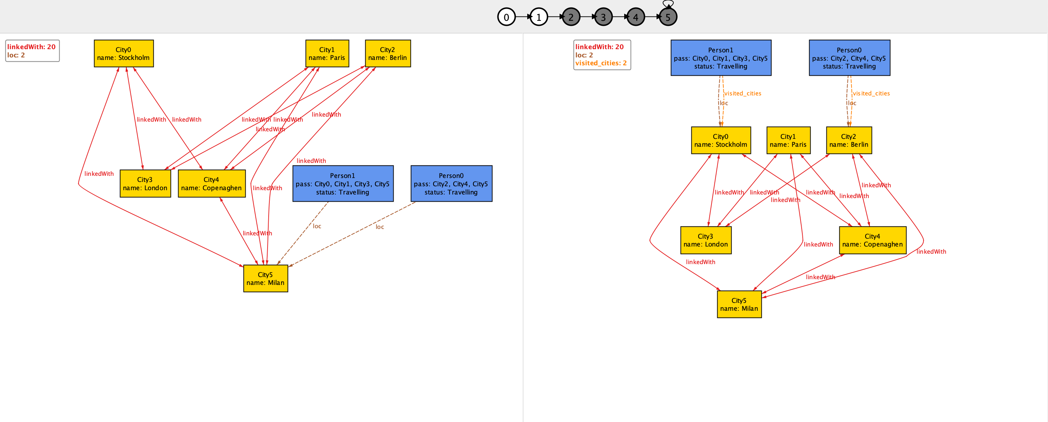
EXERCISE 2
39
Interrail: visualizer
At the beginning of the trip, both people have not yet visited any cities
Notes:
…if we open the visualizer we initially see the first step pair of our lasso trace. Note that at the beginning, as required, both people have not visited any cities yet, but then there are two visited cities because required within the run expression…

Slide 41
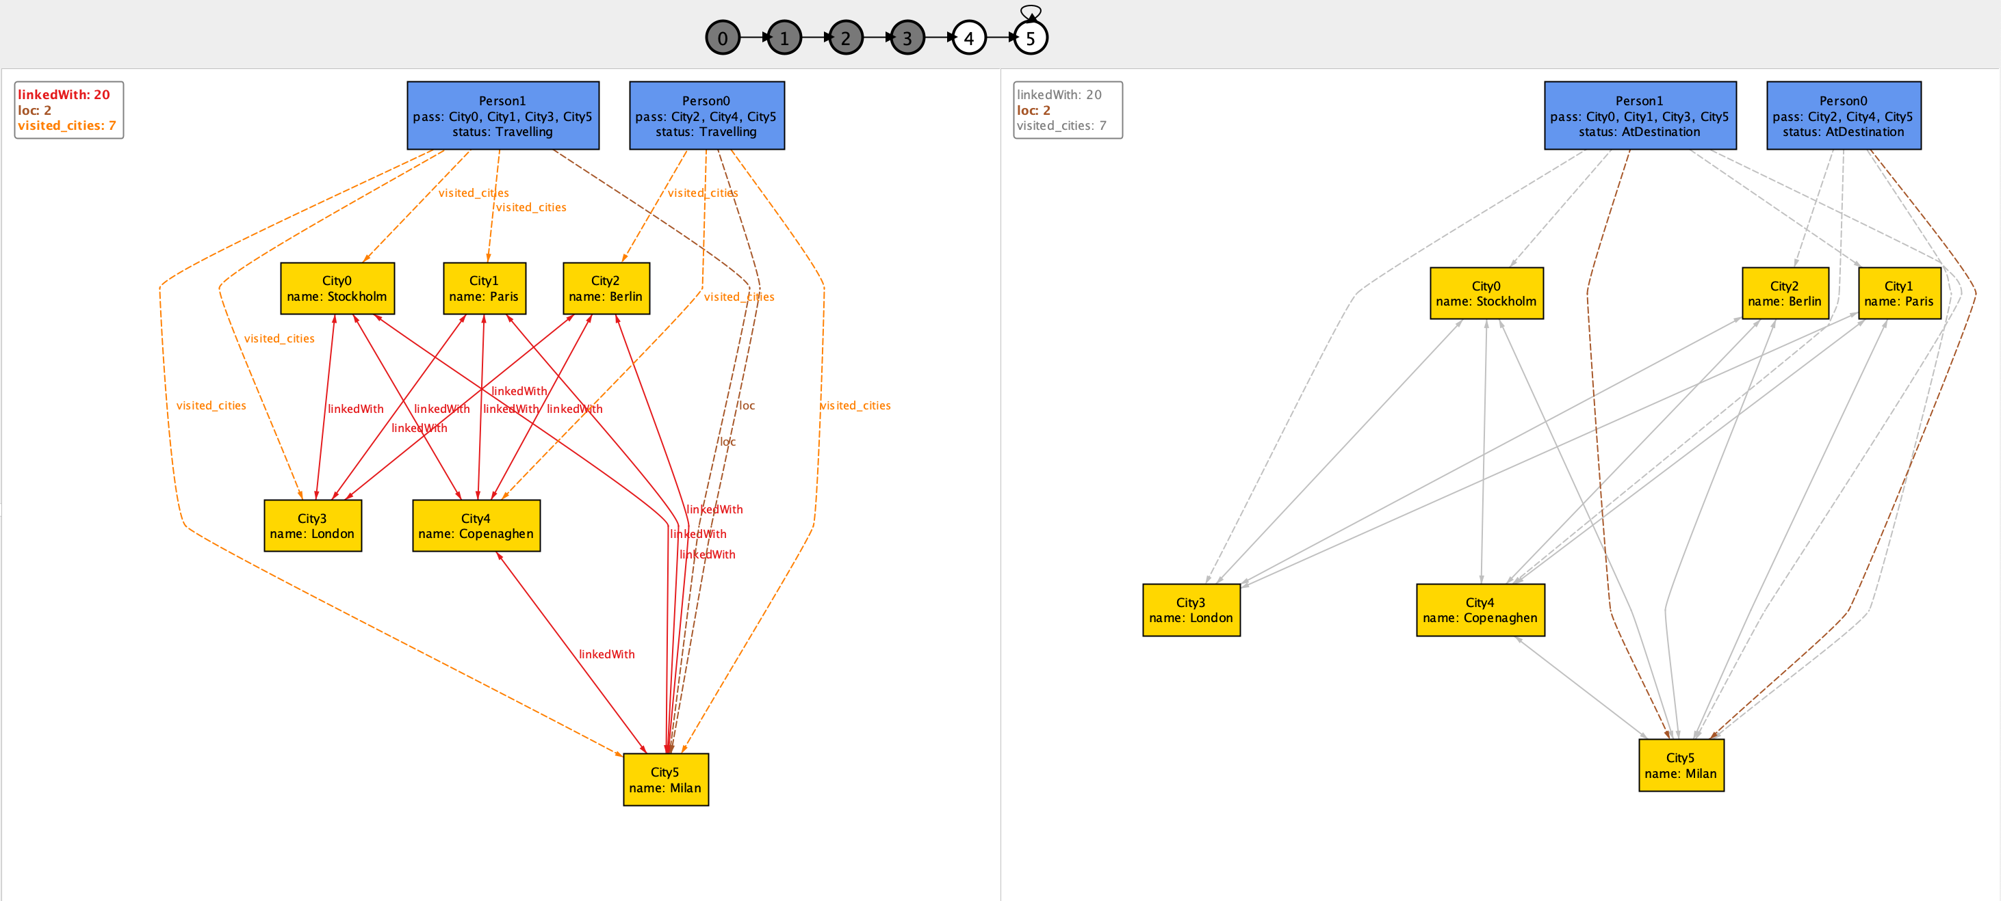
EXERCISE 2
40
Interrail: visualizer
In the final state, both Person0 and Person1 return to Milan
Notes:
…if we go all the way through our lasso trace, we get to the final state, where both people return to Milan, as required…

Slide 42

EXERCISE 2
41
Interrail: visualizer
All cities present in the pass of Person0 and Person1 are visited before returning to Milan
Notes:
…Furthermore, all cities present in the pass of the two people are visited by the respective person before they return to Milan

Slide 43

EXERCISE 3
42
Message Deletion from Mailbox
Model a scenario in which messages can be deleted from a mailbox and later restored.
Hint: The Message ends up in a Trash and can be restored from there.
Notes:
(Can be given as homework or an additional exercise for the exercise lecture)
The goal of the Trash is to enable deleted files to still be restored until an (undoable) action of emptying the Trash is made: when a file is deleted it is stored in the Trash; while still in the Trash, a file can be restored; after emptying, all files contained in the Trash are permanently deleted.

Slide 44
EXERCISE 3
43
Message Deletion from Mailbox
var sig Message {}
var sig Trash in Message {}
pred delete[m: Message] {
m not in Trash
Trash' = Trash + m
Message' = Message
}
pred restore[m: Message] {
m in Trash
Trash' = Trash - m
Message' = Message
}
pred empty {​
#Trash > 0
after #Trash = 0​
}​
​
pred doNothing {​
Message' = Message​
Trash' = Trash​
}​
​
pred restoreEnabled[m:Message] {​
m in Trash​
}​

Slide 45
EXERCISE 3
44
Message Deletion from Mailbox
fact Behaviour {
no Trash
always {
(some m: Message | delete[m] or restore[m]) or empty or doNothing
}
}
run {}

Slide 46
EXERCISE 3
45
Message Deletion from Mailbox
assert restoreAfterDelete {
always (all m : Message | restore[m] implies once delete[m])
}
check restoreAfterDelete for 10 steps
check restoreAfterDelete for 1.. steps
assert deleteAll {
always ((Message in Trash and empty) implies after always no Message)
}
check deleteAll
Notes:
Note that for complete model checking a proper solver is required

Slide 47
EXERCISE 3
46
Message Deletion from Mailbox
check MessagesNeverIncreases {
always (Message' in Message and #Message' = #Message)
}
check IfNotDeletedMessagesNotEmpty {
(always all m : Message | not delete[m]) implies always not empty
}
// A deleted message can still be restored if the trash is not empty
assert restoreIsPossibleBeforeEmpty {
always (all m:Message | delete[m] implies after ((empty or restore[m]) releases restoreEnabled[m]))
}
check restoreIsPossibleBeforeEmpty for 3 but 1.. steps

